Slide 1

Department of Industrial Engineering and Management Specialization of Information Systems
Analyzing the success factors of the Israel Employment Service placement program
Final Academic Research project
Author: C. Shalev
Co-Author: P. Davidov

Slide 2
Israel Employment Service Background
The service provides job placements and brokerage for jobseekers.
Almost 60,000 jobseekers covering 71 bureaus all around Israel.
The IES provides professional training, finding employees for employers and more.
Notes:
השירות אחראי על העברת דיווחים שוטפים למוסד לביטוח לאומי בנוגע לזכאותם של דורשי העבודה לדמי אבטלה או גמלת הבטחת הכנסה.

Slide 3
Unemployment – Overall information
The unemployed comprise all persons above a specified age who during the reference period were:
1) Without work, that is, were not in paid employment or self employment during the reference period.
2) Currently available for work, that is, were available for paid employment or self-employment during the reference period.
3) Seeking work, that is, had taken specific steps in a specified recent period to seek paid employment or self-employment.
International Labour Organization (ILO) Resolutions Concerning Economically Active Population, Employment, Unemployment and Underemployment Adopted by the 13th International Conference of Labour Statisticians, October 1982, para. 10
Notes:
אבטלה טבעית תקינה עומדת בין 4%-5%. זהו מצב תקין המהווה נקודת איזון בין הכלכלה העולמית.

Slide 4
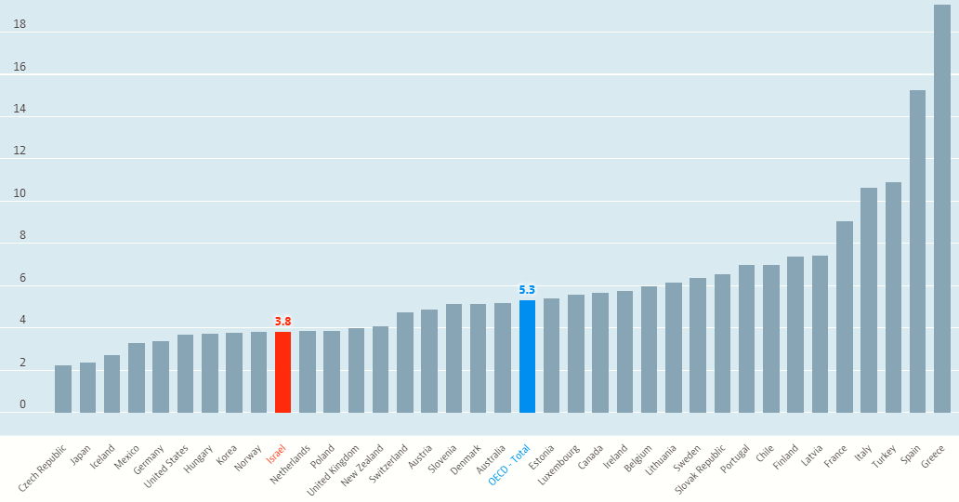
Israel compared to OECD (Before Covid-19 pandemic)
Kabáta: “There is no doubt, that unemployment represents currently the major social problem of the European Union”
* Kabáta et al. “17th International Conference Enterprise and Competitive Environment“ 2014 Volume 12, Pages 1-804.
Notes:
ישראל ממוקמת במקום ה10 מתוך 36 מדינות הOECD במדד הOECD לאבטלה.

Slide 5
Literature Survey
Social influence:
Higher local unemployment weakens the work norm (Winkelmann, 2014).
In EU countries in general, a quarter of the unemployed who suffer from economic problems also suffer from health problems, alcohol addiction, and/or discrimination (Sol, 2016)
Economic influence:
Unemployed with problematic debts indeed do have more problems returning to work than unemployed without debts (Zwinkels, 2015).
Debt relief pathways in the context of employment services do lead to more job placements, and job placement without the relief paths may be relatively limited (Koning, 2014).
* The literature survey based on 30 references.

Slide 6
Literature Survey
Psychology infuence:
Life-satisfaction rate, the unemployed is a point less than employed (Winkelmann, 2014).
There is a strong correlation between unemployment and a person's mental health, and there are gender differences in the effects of family responsibility and social status (Artazcoz, 2004).
* The literature survey based on 30 references.

Slide 7
Unemployment placement program in Israel
In 2004, Israel established a program called the "From Income Guarantee to Secured Employment" (FIGSE). The main aim of the Israeli program was to convert some of the people living in poverty from relying on National Insurance Institute (NII) benefits to the labor market. The Employment Service has set up a number of programs: Employment Circuits, Tapuah (Arabs), Age And Work, Mafteah (Haredim), Tnufa, Eshet Hayil and more.
In 2015 the percentage of labor market employment in the Arab community was 54.6% compared to 81.7% in the Jewish community (Ministry of Labor, Social Affairs and Social Services, 2015), and in 2016 the Arab employment rate was 42.5% (Central Bureau of Statistics, 2017).
Notes:
התוכנית הזכירה באופייה את תוכנית ויסקונסין.
לכן הייתה נתונה לביקורת פוליטית, ארגונים חברתיים.
בישראל יש גופים פרטיים למציאת עבודה, וגם גורם ממשלתי- שירות התעסוקה.

Slide 8




Placements Success Definition (Label’s)
Amazing Success:
* No revolving door cases, placement since enters the program = 1, no resumption date.
Medium Success: No revolving door cases, placement since enters the program > 1, no renew activity date, or no renew registration date.
Weak Success:
All job seekers who not in label 1,2 or 4.
Failure:
No resumption date, no placements since joining the program, or revolving door cases higher than 0.
* Revolving door- job seeker has returned to the program in 3 months since he was placement in a job
Notes:
כדי להתחיל בניתוח הנתונים הייתי צריך להגדיר מהו ערך המטרה- מה אני רוצה למצוא או לסווג.
החלטתי (מניסיון אישי והיכרות עם הנתונים והתוכנית) לחלק ל4 סוגים.
התנאים לכל אחד מהם בוססו נטו מהיכרות עם התוכנית והנתונים בה.

Slide 9
Data Factorizing
The database containing 82 columns and 55,989 rows. (row=job seeker, column=jobseeker feature).
The data were collected for the period from 2016-2019.
Data reclamation findings were 14% of empty cells.
Notes:
עמודות= לפרט בקטנה.

Slide 10
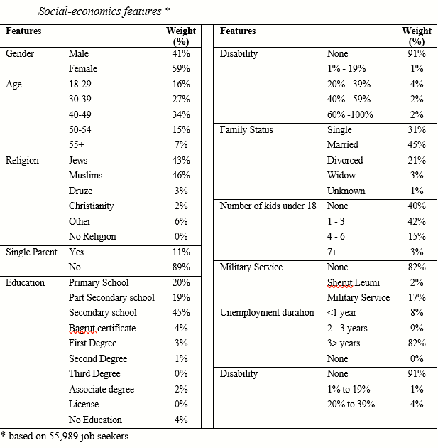
Data Factorizing
Notes:
עמודות= לפרט בקטנה.

Slide 11
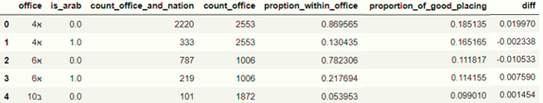
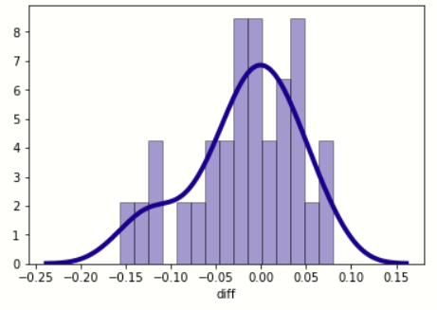
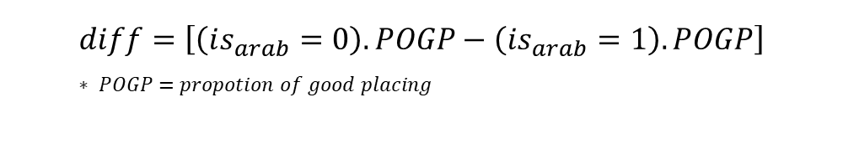
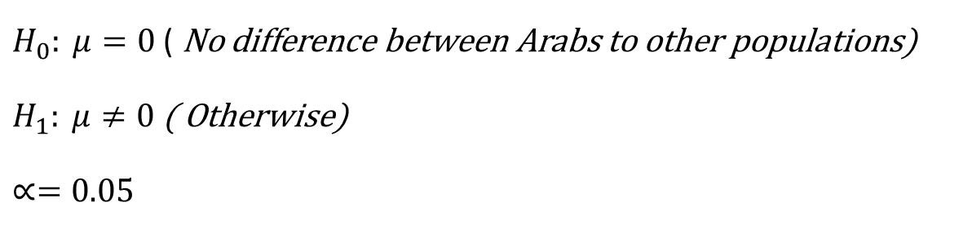
Q1: Is there a difference between good placements of the Arabic population to other populations?
$H_{0}: μ=0$ ( No difference between Arabs to other populations)
$H_{1}: μ≠0$ ( Otherwise)
$$∝=0.05$$
$$diff=\left[\left(is_{arab}=0\right).POGP−\left(is_{arab}=1\right).POGP\right] \\ ∗ POGP=propotion of good placing$$
Notes:
סיווג דו"ע ערבים: דובר השפה הערבית וגם שדתו היא לא יהודית.
*הערה - ישנם לא ערבים (שאינם יהודים) שדוברים ערבית אבל שיעורם באוכלוסייה הנו נמוך ולכן לא ישפיע רבות על התוצאה.
נלקחו 30 לשכות (שבהן יש יותר מ14 דו"ע ערבים) מתוך 71 הלשכות.

Slide 12
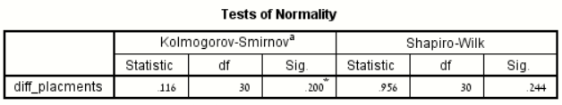
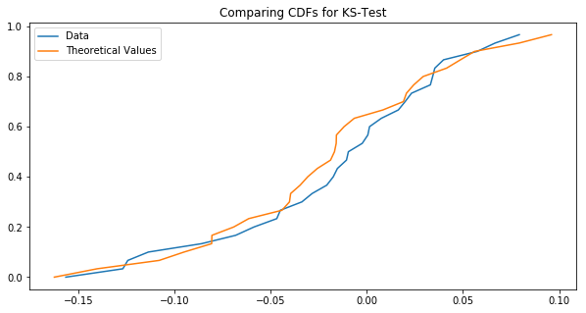
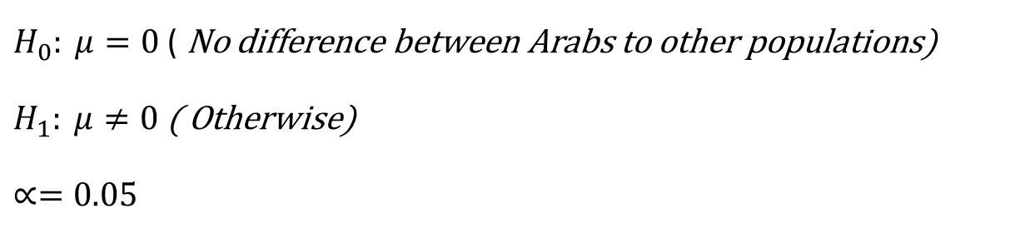

Q1: Is there a difference between good placements of the Arabic population to other populations?
$H_{0}: μ=0$ ( No difference between Arabs to other populations)
$H_{1}: μ≠0$ ( Otherwise)
$$∝=0.05$$
T-test results: $ρ=0.097$ , $∝=0.05$.
The critical value is greater than ∝.
The conclusion is to not reject the null hypothesis and conclude there is no significant difference between the job placement of the Arabs and the job placement of the non-Arabs.
Notes:
ניתן לראות בבירור כי הערך הקריטי $ρ=0.2$ , $∝=0.05$ ולכן נאמר כי לא נדחה את השערת האפס ונאמר שהנתונים מתפלגים בצורה נורמלית.
מובהק- אומר שבהסתברות גבוהה הוא מייצג את המצב הקיים.
לכן בוצע מבחן T כי נורמליות נבדקה על הנתונים

Slide 13
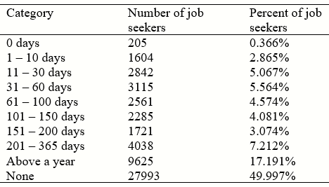

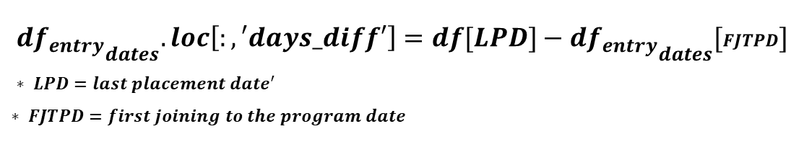
Q2: How long job seekers are in the program before their placements ?
$$d{f_{entry}}_{dates}.loc\left[:,′days_diff′\right]=df[LPD]−d{f_{entry}}_{dates}[FJTPD] \\ ∗ LPD=last placement date^{′}$$
$$∗ FJTPD=first joining to the program date$$
Confidence interval is:
(0, 341.42, 1081.56) [days] $∝$= 0.05
σ = 377.624 (days)
Notes:
יותר מ25% יש להם הפרש שלילי, משמע בעיה בנתונים שהוכנסו למערכת.

Slide 14
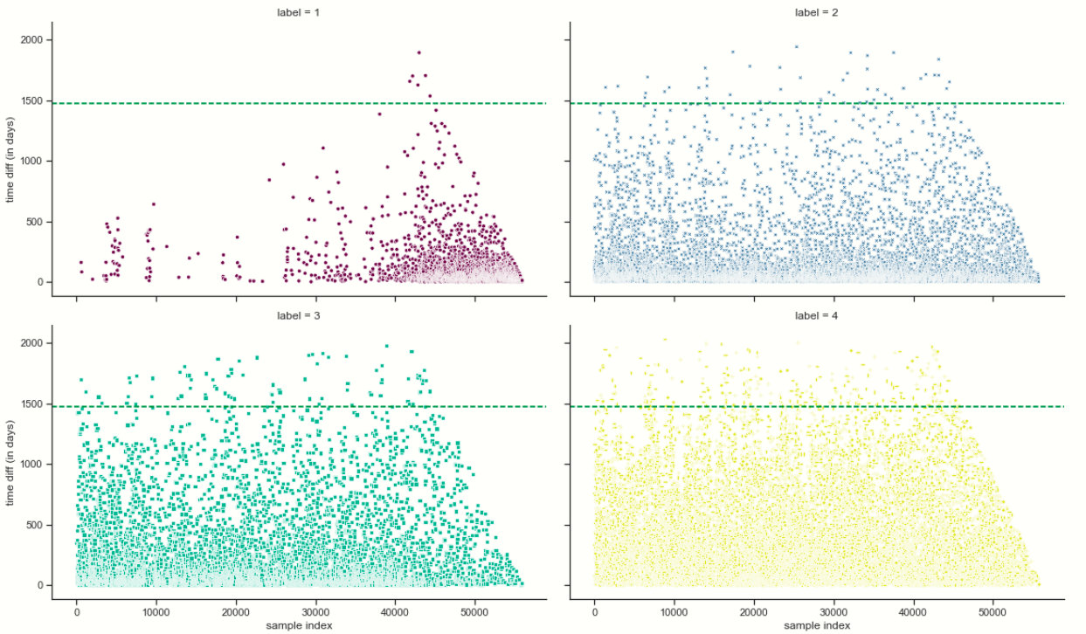
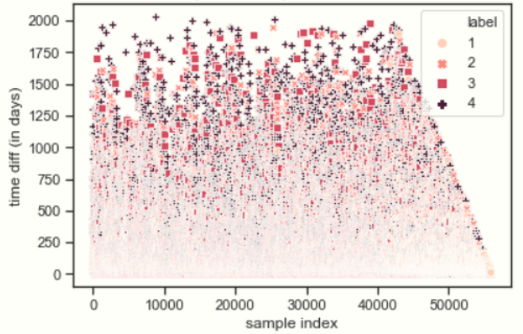
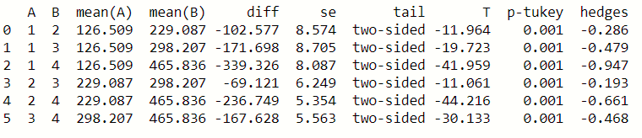


Q3: Is there a difference between the time length of jobseeker in the program to type of placement ?
$$H_{0}:There is a difference$$
$$H_{1}:No difference$$
$$∝=0.05$$
Notes:
השימוש בANOVA בגלל שהוא מנתח הבדלים בין 3 ממוצעים או יותר.
השערת האפס של ANOVA היא שאין הבדל בין הממוצעים של הקבוצות.
יח' המשתנה הנמדד הוא ימים בריבוע.

Slide 15
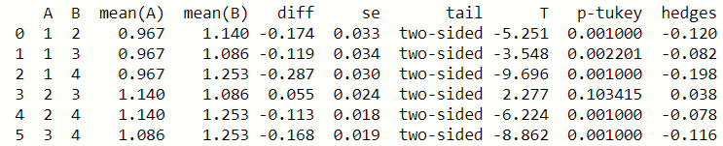


Q4: Do the number of activities
from the program influence job seeker's placements ?
Notes:
יחידות במספר תוכניות בריבוע.
השערת האפס של ANOVA היא שאין הבדל בין הממוצעים של הקבוצות.
החלטתי לבדוק בין זוגות הלייבלים לראות הבדלים בעזרת מבחן Tucky post hoc.
ניתן לראות שיש הבדלים חוץ מזוג לייבלים 2,3 בגלל קרבתם ההגדרתית.

Slide 16
Q4: Do the number of activities
from the program influence job seeker's placements ?
Decision tree model take a sample of jobseekers from the data frame and match their socioeconomic characteristics and activities to the data frame.
1) Easy analysis by graphicly figure.
2) The model shows the most definite route, so the tree should be considered as the order of best practice for those sampled job seekers.
The model don’t definite promise that according to the proposed route, job seekers will be implemented in this way.
Notes:
לאחר חקירת הפעילויות, בוצע מודל עץ החלטות אשר יקח דגימה
הסידור בוצע על: ציון התאמה אחרון, עומק אבטלה בחודשים, קבוצות גילאים, השכלה, שפה, דת.
השתמשתי שוב בעמודת הפעיליות שעבר תכנית המסודרת עם 30 הפעילויות הייחודיות.
למה לא להשתמש בrandom forest? כי הוא דוגם חלק מהנתונים ויותר המון עצים (מסלולים).

Slide 17
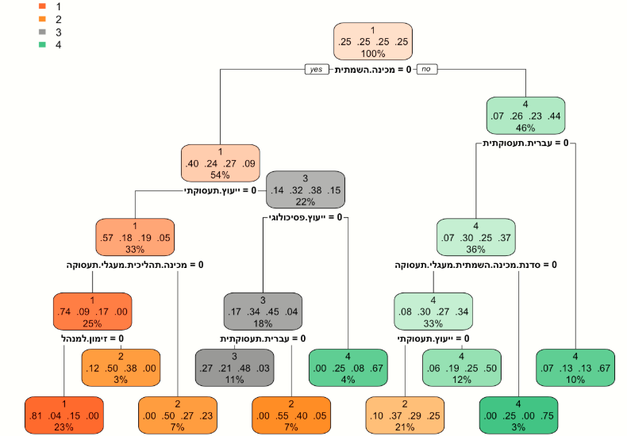
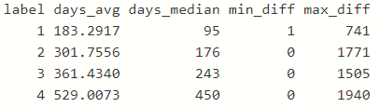
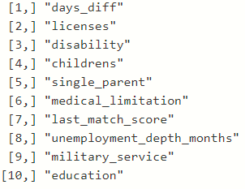
Q4: Do the number of activities
from the program influence job seeker's placements ?
Notes:
1 – 23%
2 – 7%
2 – 3%
נראה שישנו קשר אשר אומר להפחית בפעילויות שהדו"ע עובר בתוכנית.
ככל שימעיט בהן, סיכוי ההשמה שלו יגדלו ויהיו איכותיים יותר.

Slide 18
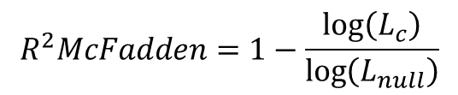
Q5: Is there an influence between
socio-economic jobseeker characteristics to placement ?
The definition of socioeconomic characteristics of jobseekers are religion, age, single parent, gender, level of education, city, language, country of birth, marital status, children up to age 18, classification of the jobseeker, disability rates, medical disability, licenses, military service, released prisoner and month of placement ("last placement date").
Model result: 0.2368
Excellent fit in this model between 0.2 - 0.4.
$$R^{2}McFadden=1−\frac{\log\left(L_{c}\right)}{\log\left(L_{null}\right)}$$
* Daniel McFadden, "Quantitavie methods for analyzing travel behavior of individuals: some recent developments", November 2, 1977. https://thestatsgeek.com/2014/02/08/r-squared-in-logistic-regression/
Notes:
שימוש במודל רגרסיה מולטינומית בגלל שזהו קלסיפיקציה של נתונים- יש יותר מ2 דרכים אפשריות והערכה של המודל היא ההסתברות של כל פרמטר להשתייך לקבוצה מסוימת.

Slide 19
Q5: Is there an influence between
socio-economic jobseeker characteristics to placement ?
There are more Arab cities compered to Jewish cities in labels 1 and 2. Muslim and Jew religions significantly more to be in label 1. All that supporting question 1 results and conclusion.
Some country origin effects on program success, like the Soviet Union and France significantly more to be in label 3 than label 1 (compered by p-value). Ethiopia significantly more to be in label 2.
Notes:
Some of the model results can be present as commonsense thinking, but some can surprise us all.
All model results are compared to label 4 (failure) and each model result was displayed is significant (ρ < 0.05).

Slide 20
Q5: Is there an influence between
socio-economic jobseeker characteristics to placement ?
3) Education has a strong effect on the success label. Academic degree or high school matriculation has significantly more to be in label 1, and non-education significantly more to be in label 3.
4) Disability affects human life including program success. From 20%-59% significantly more to be in label 2 and 60%-100% to be in label 3, but no disability at all significantly more to be in label 2 and not 1 as we expected.

Slide 21
Conclusions & Recommendations
There is no difference between the placement of the Arabs and the placement of the non-Arabs.
The number of job seekers placed through the program is 50% which indicates a low rate of placements.
Longer the jobseeker being in the program, the quality of his placement (label) decreased.
There is an influence between socioeconomic characteristics on the type of success in the program.

Slide 22



